Slide 1


TSL Estates
TEL Automation Project Report
Prepared By: Innocent osoria August 2023

Slide 2


TSL Estates
Content Outline
Executive Summary
Project Summary; Business Case
Project Scope
Design and Development Milestones
Testing & Feedbacks
Risk Management
Project Team structure
Project Resource Management
Communication Management

Slide 3
Project Overview
TSL Estates
Following an extensive review of leading FM organizations, the Estate team identified operational gaps within our current system that adversely impact client experience.
A recurrent issue among some of our clients (IASL, TML, TSL, Capital core) is the difficulty in identifying which request form that we currently use corresponds to their specific needs. Additionally, it was also noticed that people are unaware of the full spectrum of services we provide. This not only hinders our clients' ability to leverage our offerings but also limits our chances to help them.

Slide 4
Project Deliverables
TSL Estates
The proposed project offers:
A unified platform for all estate-related service request forms.
Backend integration designed to send immediate notifications to the facility group when forms are submitted.
An organized backend, segmented according to different companies.
Consolidation of all existing TEL activities (payment tracker and Rental information, etc.) into a singular SharePoint location.
Establishment of a dedicated service email and a centralized group email for TEL.
Seamless integration with PowerBI, facilitating the automated generation of weekly and monthly report dashboards, essential for informed decision-making.
Incorporation of a feedback form to gauge customer satisfaction, allowing us to gather insights and respond to client needs proactively.

Slide 5
Project Goals, Business Outcomes & Objectives
TSL Estates
Goal and Objective
Improve TEL's operational effectiveness and client interaction by creating an integrated solution that consolidate TEL’s existing services into a streamlined, automated platform. Objectives: Streamline Service Requests: Design a unified platform for all TEL related service request forms to ensure clients can identify and use the correct forms for their specific needs. Improve Internal Communication. Centralize TEL Activities: Combine all existing TEL activities such as payment tracking and rental information into a single SharePoint location. Facilitate Informed Decision Making: Integrate seamlessly with PowerBI to automate the generation of weekly and monthly report dashboards. Measure and Enhance Client Satisfaction: Introduce a feedback form to capture customer satisfaction metrics and gather insights to respond proactively to client needs.
Business Outcomes
Increased Client Satisfaction: By making it easier for clients to find the right service request forms and be aware of the full range of services, the client experience is enhanced, leading to better client relationships and potential referrals. Efficient Operations: Immediate notifications and centralized communication tools will reduce response times and potential bottlenecks, ensuring a smoother operational flow. Data-Driven Decisions: With the integration of PowerBI and real-time dashboards, decision-makers will have access to timely and accurate data, fostering informed strategic decisions. Proactive Problem Resolution: Gathering insights from the feedback form allows TEL to preemptively address issues or identify areas of improvement, leading to continuous service enhancement.

Slide 6
Project Scope
TSL Estates
SN | Project Stage | Description | Status
1 | Initiation and planning | Requirements gathering, Resource allocation, Budgeting, Risk assessment, Stakeholder alignment | Completed
2 | System Design | Design the architecture of the integrated system based on the needs analysis. | Completed
3 | Platform Selection | Choose the right technological platforms and tools that will host and support the system. | Completed
4 | Development | Begin coding, configuration, and setting up the system. | Completed
5 | User Acceptance Testing | Allow TEL team or a select group of users to test the system, ensuring it meets user needs and expectations. | Completed
6 | Deployment (Go live) | Roll out the system for wider use among TEL's clients and staff. | Pending
7 | Training | Organize sessions to train staff on using the new system | Not Started
8 | Feedback Collection | Initiate a phase where users can provide feedback on any issues or improvements. | Not Started
9 | Continuous Improvement | Based on feedback, make necessary enhancements and updates to the system to ensure it remains effective. | Not Started

Slide 7
Design and Development Milestones
TSL Estates
The table below shows the list of Achievements till Date:
S/N | Requirement | Feature | Progress Status
1 | Consolidate all forms on a Canvas app | A singlepage canvas application | 100%
2 | Create a SharePoint team site that doubles as a Backend for forms | Sharepoint site for forms | 100%
3 | Create Facility Management Group mail | Group email | 100%
4 | Create a service Email Adress |  | 100%
5 | Create request forms for | Request forms list within the Canva App | 100%
 | •Work Order Request
 | •Guest House bookings
 | •Pool Vehicle Request
6 | Create a subsite within TSL estate main site for CapitalCore, IASL and TSL | Subsite within the main Sharepoint site | 40%
7 | Create Facility activity related tracker on Sharepoint | List within the Sharepoint site | 60%
8 | Create a central dashboard on Sharepoint for all list using Power Bi API’s | A central dashboard for activities | 30%
9 | Generate end of the month report for Facility management | Automated end of the month report | 0%
 |  |  | 70%

Slide 8
Testing & Feedbacks
TSL Estates
SN | Project Stage | Description | Status
1 | Preliminary Testing | About 3 different tests were conducted to evaluate the system's basic functionality and interface design. Some glitches were identified during the initial testing phase and feedback was shared and resolved | Completed
2 | Re-Testing | After addressing the discovered issues from the preliminary test, the system was re-evaluated with the IT manager, the development team, and the TEL team. The outcomes showcased an improvements from the initial tests, paving the way for a recommendation to proceed with the launching (Go live). | Completed
3 | Integration of Existing Activities | Work on integrating all the existing activities(payment tracker, rent tracker, etc) within the new system to provide a consolidated platform. | Pending
4 | Reporting Integration | Incorporate the reporting mechanisms, ensuring data from the system can be easily extracted, analyzed, and visualized. This will also integrate with platforms like PowerBI. | Pending
5 | Advanced Feedback Collection | After the integration of existing activities and reporting, another feedback round will be conducted to ascertain any further improvements or adjustments needed. | Not Started

Slide 9
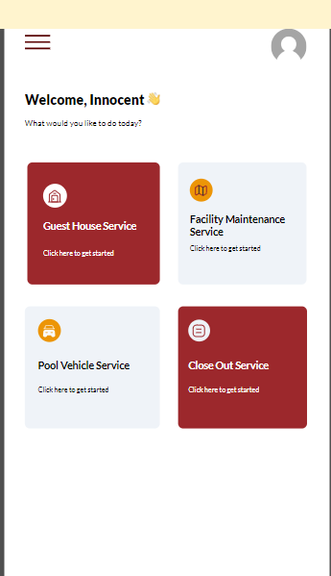
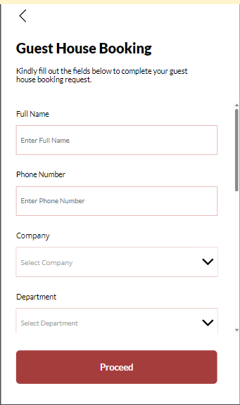
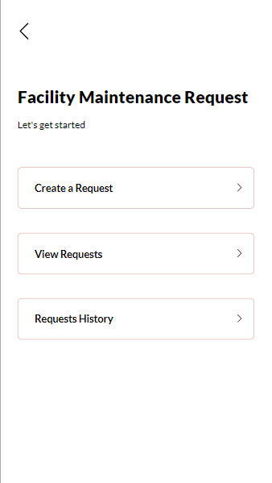
Project Interface
TSL Estates

Slide 10
Risk Management Matrix
TSL Estates
Risk | Probability | Impact | Mitigation Strategy
Resistance to change from staff | low | Medium | Implement comprehensive training programs. Conduct frequent communication and feedback sessions to address concerns.
Technical Glitches | Medium | High | Implement robust post-deployment monitoring. Train staff to report issues promptly. Have a dedicated IT support team ready.
User errors due to unfamiliarity with the new system | High | Medium | Offer hands-on training sessions. If possible, Set up a helpdesk for immediate user support.
Security vulnerabilities in the new system | Low | High | Conduct regular vulnerability assessments.
Infrastructure Failure (Downtime) | Medium | High | Regular backups

Slide 11
TSL Estates
Additional information

Slide 12
Project Team structure
TSL Estates
Project Sponsor
Project Manager
Dev Team
Cooperate comms
TEL Team

Slide 13
Project Resource Management
TSL Estates
No | Role/ Department | Department | Task Owner
1 | Project Sponsor | TSL Estate | Anne Oseragbaje
2 | Project Head | TSL Estate | Anne Oseragbaje
3 | Project Manager/Supervisor | TSL Estates | Osoria Innocent
4 | Dev Team lead | Capital core | Benjamin Achebe
5 | Dev Team member | TSL | Harrison Eze
6 | Cooperate comms | TSL | Funmi Taiwo

Slide 14
Communication Management
TSL Estates
Communication Activity | Participants/Document Recipients | Frequency of Communication Activity | Person Responsible for the Communication Activity | Distribution Method
Kick-off meeting | Project Team | Once | Project Manager | Email Invite
Project Team Meetings | Project Team | Weekly | Project Analyst | Invitation via teams
Project Status Report | Project Sponsor | Bi-weekly | Project Manager | Via email
Project Document (Schedule, risk register etc..) | Project team | As required | Project manager | Via email to selected project team members.
Minutes of Meeting/ Action items | Project team | 48hrs after scheduled meeting | Project Analyst | Email

Slide 15
TSL Estates
Thank you!

